Slide 1






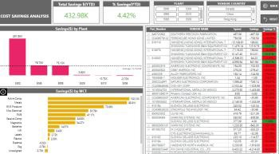
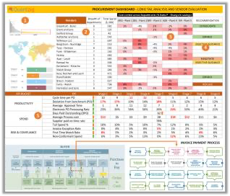
Post Pilot, we propose a Managed Services model for this engagement where an engagement lead and identified set of dedicated FTEs will support NHS in the end-to-end implementation of the commercial intelligence solutions.
FIRST MONTH
QZ TEAM
KICKOFF & CONTEXUALIZATION
WEEKLY REVIEW
MONTHLY BUSINESS REVIEW / QBR
Roadmap ideas
New technologies and solutions overview, new innovations from Quantzig thought leadership team
NHS TEAM
Roadmap documentation Objectives documentation Milestone and goals agreement Architectural discussions
Weekly work prioritization Weekly productivity review Backlog creation and prioritization
Account Manager
DEPLOYMENT in 2-4 Weeks
Steering Committee
Engagement Lead
Engagement and scrum frequency agreement Communication protocol agreement
ARTIFACTS
Project tracker Resourcing tracker
ARTIFACTS
Roadmap Tracker Innovation tracker
Project PoC
Dedicated
FTE Team
Access setup
Data context discussion
Governance between?
Artifacts
Our Governance Model
Operational Governance
Project Lead at Quantzig and
the client’s internal team
Weekly reviews, Project Tracker
We highly respect your data security concerns, and we are ISO 9001 and ISO 27001 certified
We connect to your data using VPNs, VMs and Remote Desktop as the data continues to reside in your environment
InfoSec Adherence
Engagement
Governance
Delivery Lead, Account Manager Manager and client PoC
Monthly reviews &
Quality Tracker
21

Slide 2
The Proof-of-concept solution can be completed in a 6-8 week period to demonstrate the value through a prototype and we can provide a scale up plan to operationalize the initial solution.
CATEGORY | SUB-TASKS | WK 0 | WK1 | WK2 | WK3 | WK4 | WK5 | WK6
Data Gathering | Data discovery and review of final scope of work for PoC
 | Data acquisition for prototype development
Data Sanitization | Cross-source data integration at sublevels
 | Data treatment for analytical cube development
Dashboard Design | Deep Dive & Solution design / wireframing
 | Exploration to create derived features
 | Business Signoff
Dashboard Development | Data flow & Data operations automations
 | Workflow setup and customization
 | UI / UX, Tool Development
 | Code Modularization and results documentation
 | User Acceptance
Deployment | Code packaging, Results Collation, and documentation
 | Training and Consumption Support
Engagement Duration | 6-8 Weeks
Tools and Technologies Used | (To be discussed with NHS)
Deliverables | Proto type Dashboard with user acceptance Documentation of Approach, Design and a scale up
Project Execution Environment | NHS IT environment (either VM based or Cloud service like Azure ML)
Cost of Execution | ~$20000 (No cost)
Data Requirements | “data requirements” document will be shared once use case finalized
Governance Cadence | Pre-kick off workshop for finalization of scope Weekly catchup for PoC review Final presentation with wider audience group
** Detailed project plan, high level design specific to the use case identified will be shared once it is finalized & confirmed
19

